Slide 1
E+ Co-Simulation in Simulink
Zhelun Chen
08/20/2020

Slide 2
Outline
Installation of EnergyPlusToFMU
Running E+ FMU in Simulink
Setup interface in E+

Slide 3
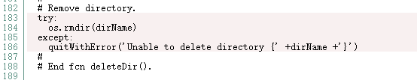
Installation of EnergyPlusToFMU
Search for EnergyPlusToFMU, follow the installation guide https://simulationresearch.lbl.gov/fmu/EnergyPlus/export/userGuide/download.html
Some issues you may encounter during installation
Make sure you change the directory for Visual Studio for all batch files in the script folder.
If you cannot generate the .fmu file, it is probably because some folders cannot be removed. If so, disable the following code in the utilManageCompileLink.py
download
mine

Slide 4
Running E+ FMU in Simulink
Use the example .idf files in the example folder
Create your FMU file, follow the instruction: https://simulationresearch.lbl.gov/fmu/EnergyPlus/export/userGuide/build.html
Or you can write a batch file to easily run python
Load .fmu into Simulink using a FMU block
Set stop time to be at least 86400 seconds
Double-click FMU block, set communication step size to be the same as in E+. For example, E+ uses 6 steps per hour, the step size is 600 seconds
Python script location
.idd location
.epw location
.idf location

Slide 5
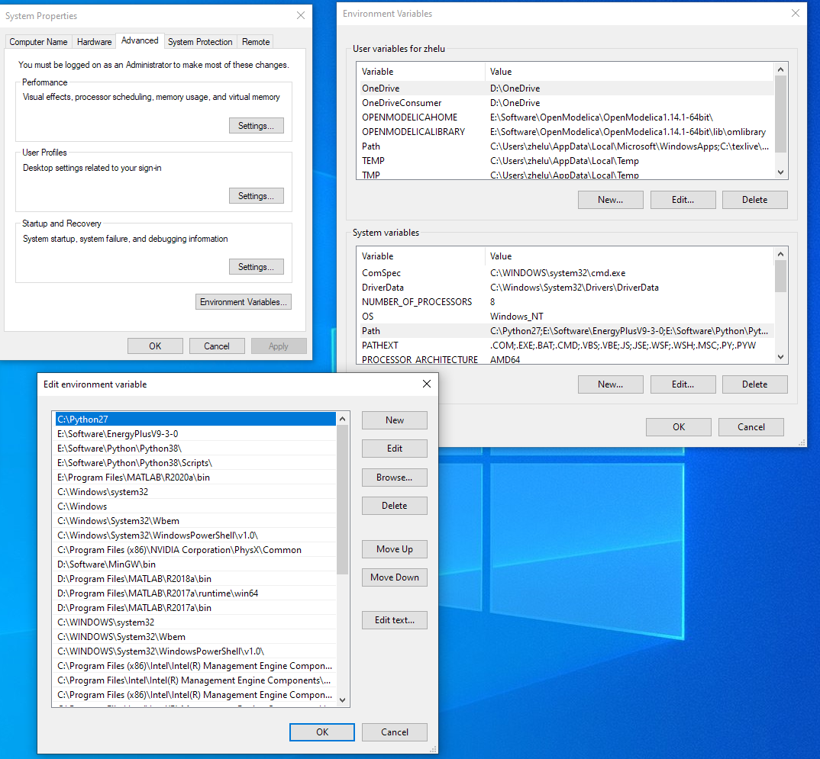
Running E+ FMU in Simulink
Before running, make sure E+’s path has been included in the computer environment

Slide 6
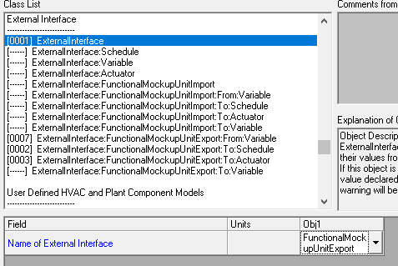
Setup interface in E+
How to setup your own .idf file for FMU co-simulation
output
input

Slide 7
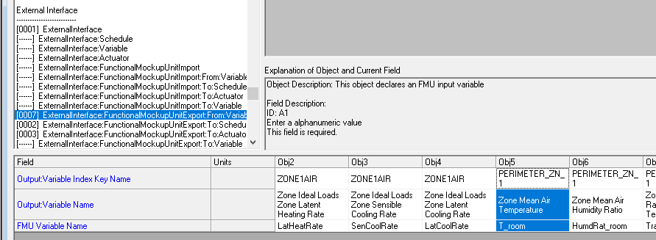
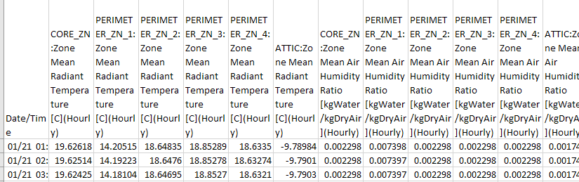
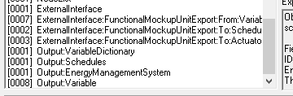
Setup interface in E+
Properly define outputs
Only variables included in Output:Variable can be export
Check output file for the Key Name
Variable Name can be selected after running the E+ model one time with Output:VariableDictionary turn on
check output file
You name it
Key Name
Variable Name
export

Slide 8
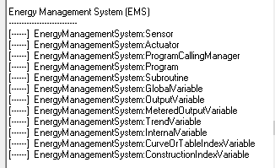
Setup interface in E+
Simple interaction
To:Schedule
High-Level interaction
To:Actuator or To:Variable
Works with EMS
Allow you to change a lot of things. For example, you can override the supply air conditions.
Read E+ EMSApplicationGuide.pdf for details

Slide 9

Setup interface in E+
Before converting to FMU, check the .idf with text editor
After editing with idf editor, Version and Version# may appear in different lines
Make sure Version and Version# are in the same line

